Slide 1

Independent Study Update: MMTN Week 4
Karthik 2021.11.12
AMLL

Slide 2
Overview
Your suggestions on last week’s update
Some next steps

Slide 3
Geometry Exploration (I/VI)
Takeaway from last time – quintuple dataset
Your suggestion: f(x) colormap background, line connecting scatter points, color = log error
Also started saving models (messed it up on hypersweep but working now)
For the following slides:
Uniformly sampled 100 points from [-1, 1] (also have identical visualizations for 500)
Plotted log error
Error – squared difference between true y value and either simulator(g) or forward(g)

Slide 4
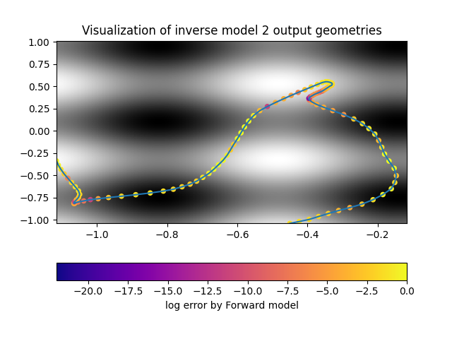

Geometry Exploration (II/VI)
Gap between error for model 2 between forward model and true simulator is gone after increasing dataset size
Not sure how to judge this in relation to y-values (in the background)

Slide 5
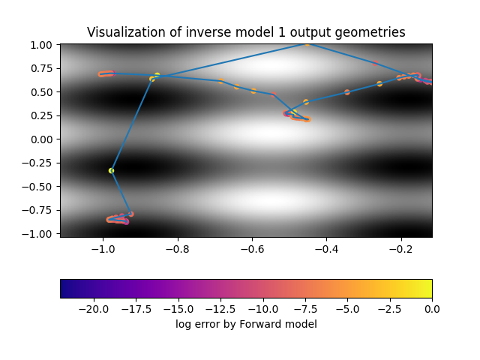
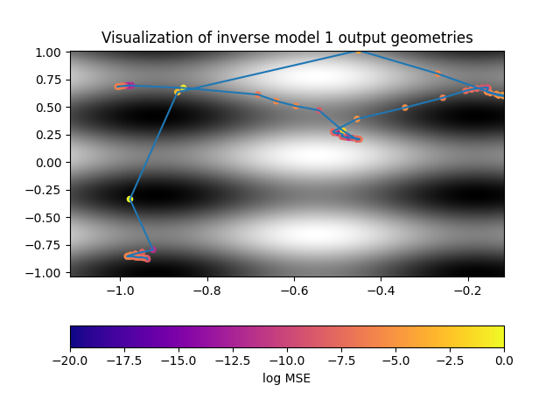
Geometry Exploration (III/VI)
For reference, model 1 – gap is generally gone again
Very sparse sections have higher errors than denser areas – reminds me of what we noticed 2 weeks ago about jump points

Slide 6
Geometry Exploration (IV/VI)
Interestingly, both model 1 and model 2 converged to very very similar errors (~0.026, overall error of ~0.006), curious to investigate if this is a pattern or a coincidence with this particular run

Slide 7
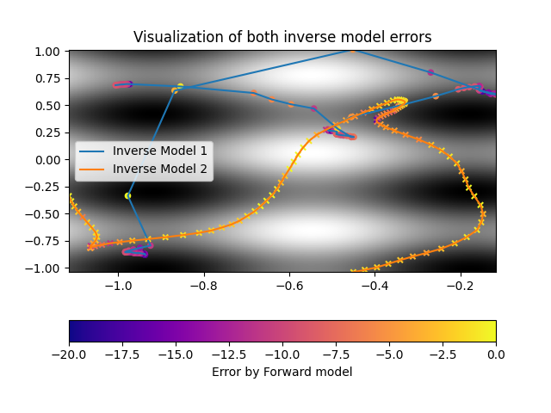

Geometry Exploration (V/VI)
Both models plotted on top of each other

Slide 8
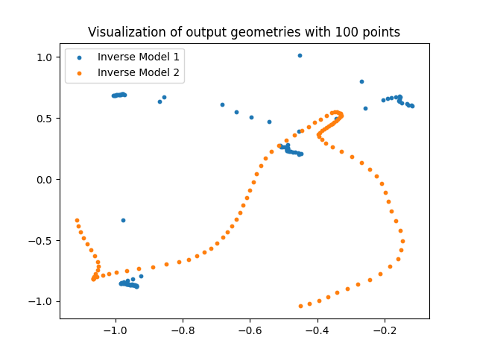
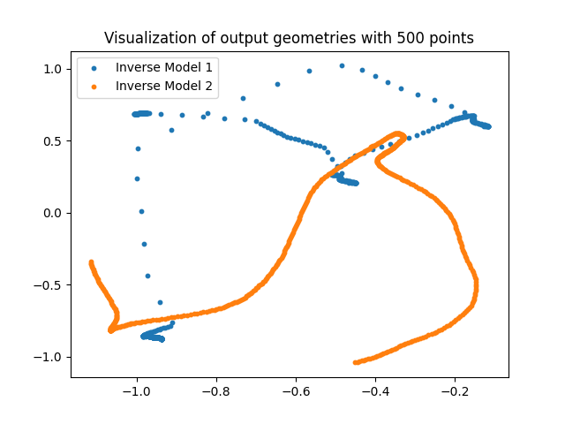
Geometry Exploration (VI/VI)
Pretty spare geometry model 1, much more standard for model 2
Unsure what is meant by looking at log of this – get errors and vertical lines

Slide 9
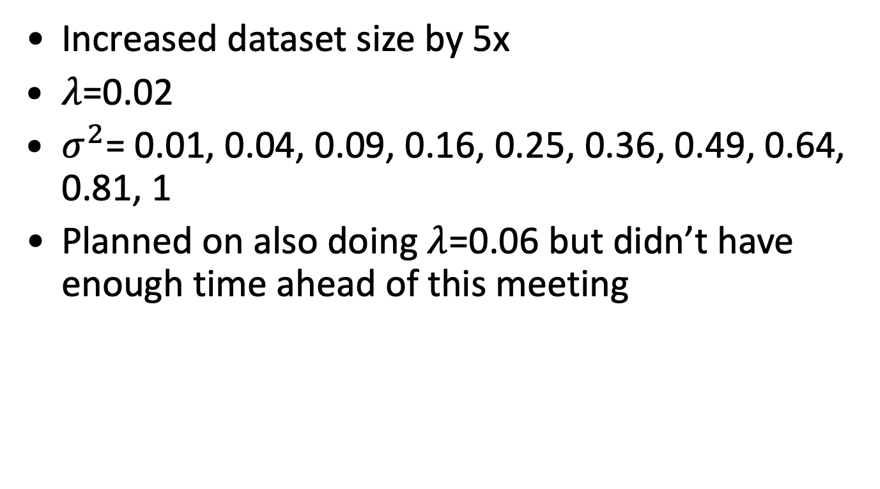
Next steps - hypersweep
Increased dataset size by 5x
$λ$=0.02
$σ^{2}$= 0.01, 0.04, 0.09, 0.16, 0.25, 0.36, 0.49, 0.64, 0.81, 1
Planned on also doing $λ$=0.06 but didn’t have enough time ahead of this meeting

Slide 10
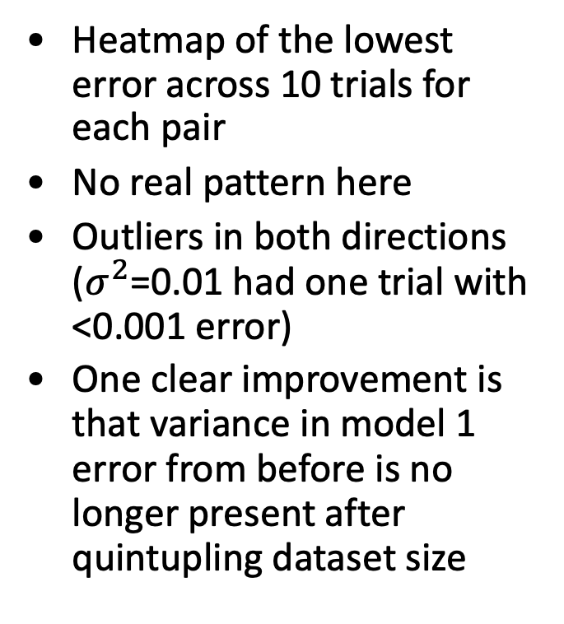
Hypersweep results (I/IV)
Heatmap of the lowest error across 10 trials for each pair
No real pattern here
Outliers in both directions ($σ^{2}$=0.01 had one trial with <0.001 error)
One clear improvement is that variance in model 1 error from before is no longer present after quintupling dataset size

Slide 11
Hypersweep results (II/IV)
Heatmap of the mean error across 10 trials for each pair
Again, everything seems similar, but the entire colormap is heavily thrown by one parameter pair that was skewed by a single extremely high error

Slide 12
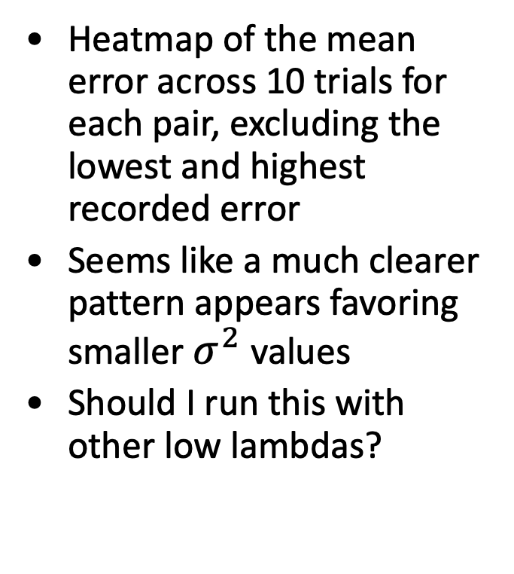
Hypersweep results (III/IV)
Heatmap of the mean error across 10 trials for each pair, excluding the lowest and highest recorded error
Seems like a much clearer pattern appears favoring smaller $σ^{2}$ values
Should I run this with other low lambdas?

Slide 13
Hypersweep results (IV/IV)
Previous result on left (just with min), vs mean – min/max on right
Should I rerun this hypersweep?

